Slide 1
Change Point Detection
Adam Yang
5/12/2021

Slide 2
Motivation
Problem: Large list of parameters that are not manually monitored
Automate a way to detect change points in unmonitored list of parameters
Vision: Flag however many change points occurred each month, hand them off to experts for manual review
List of parameters, change date, change lot, category (Device, Inline, etc.)
Pdf of graphs showing change point trends

Slide 3
Background
Charles Truong created the “ruptures” python package that includes the change point search algorithm that I use
Truong, C., Oudre, L., & Vayatis, N. (2020). Selective review of offline change point detection methods. Signal Processing, 167.
Pruned Exact Linear Time (PELT) search method
Search for a point in the trend that minimizes the cost function meanwhile pruning away points that could never be the change point
O(N) implementation where N is the the number of datapoints per parameter

Slide 4
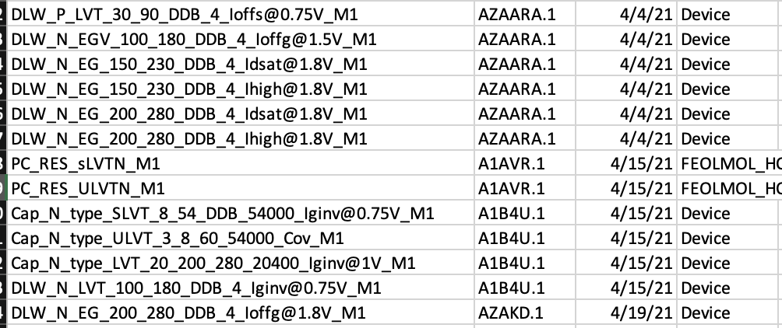
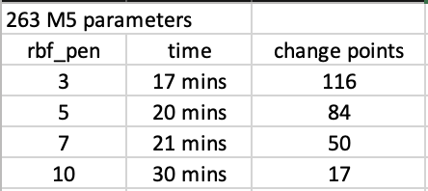
Logistics
708 M1 parameters: 43 minutes to run (3.7 seconds per parameter)
343 historical change points detected (Over half of these are DD2 shifts)
13 change points detected in April (4 unique change points)
9 change points detected in March (3 unique change points)
263 M5 parameters: 20 minutes to run (4.5 seconds per parameter)
84 historical change points detected
12 change points detected in April (3 unique change points)
9 change points detected in March (3 unique change points)

Slide 5
Proof of concept: DD2
DD2 brought a lot of shifts in all sorts of parameters.
Being able to catch these shifts can act as a proof of concept

Slide 6
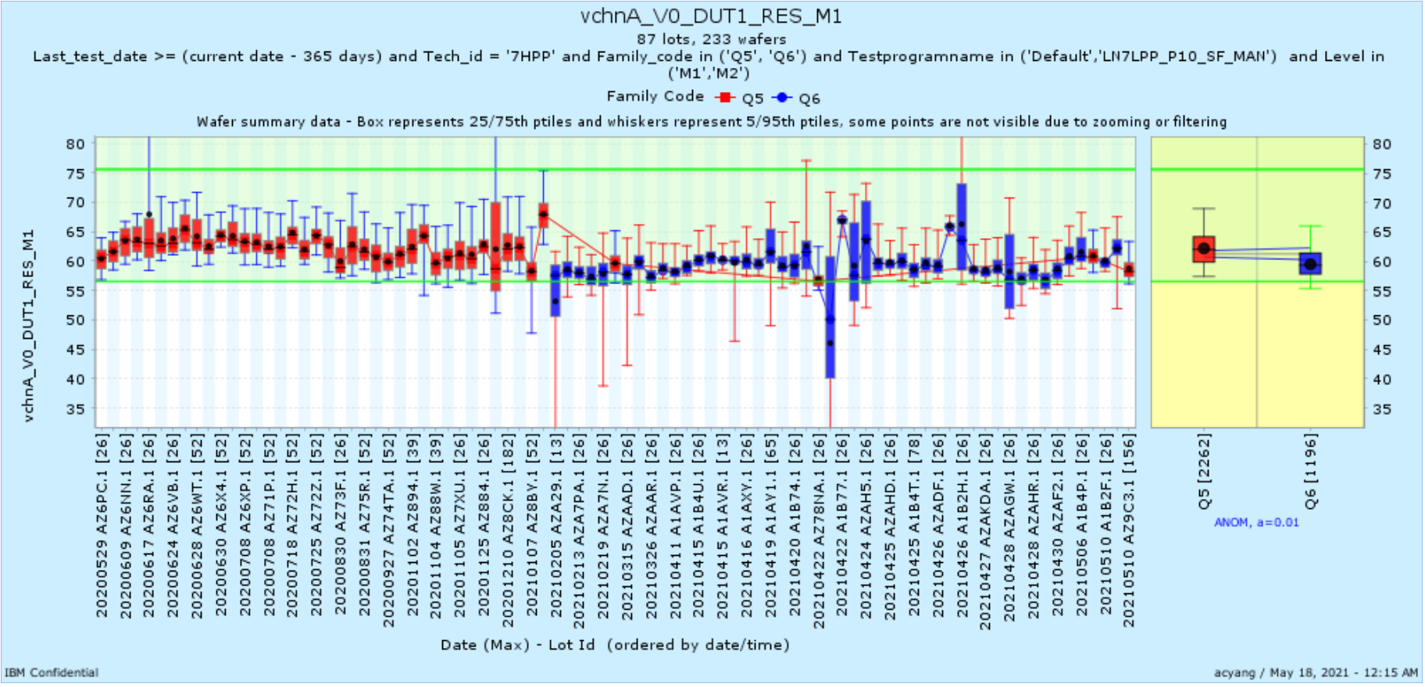
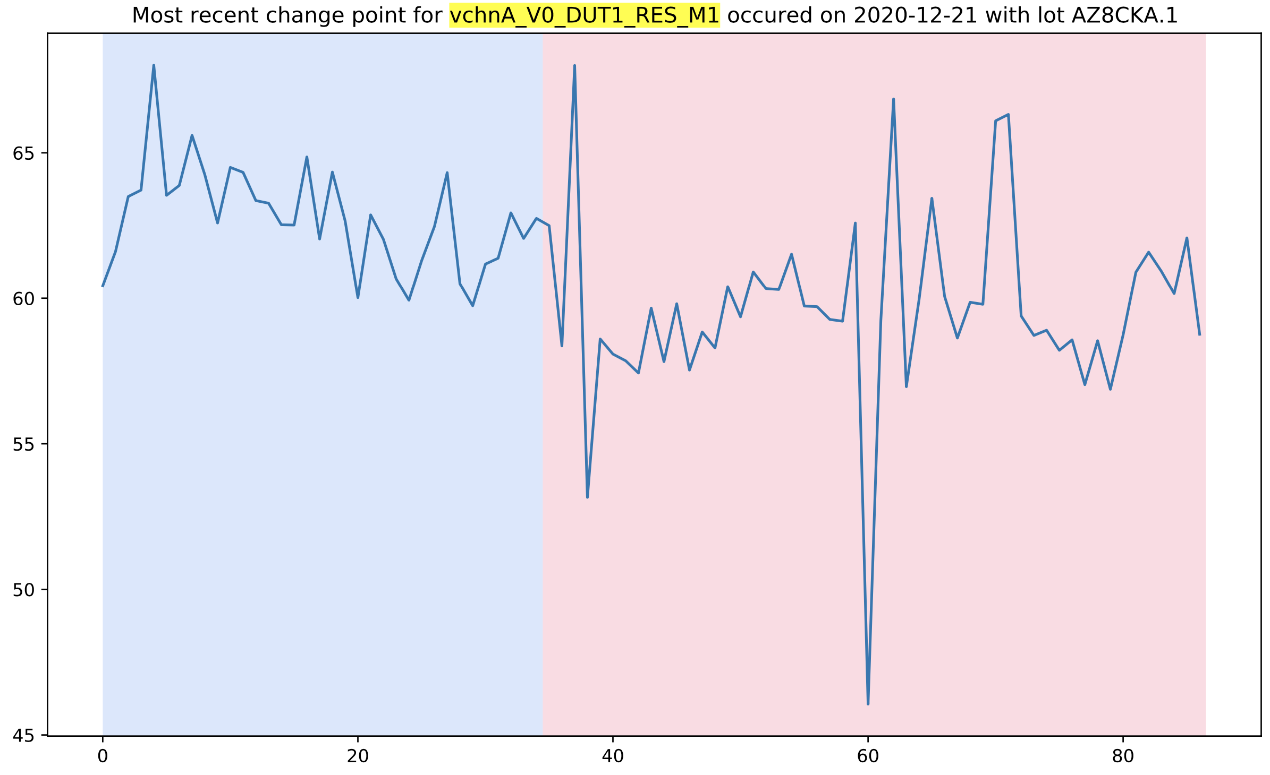
BEOL

Slide 7
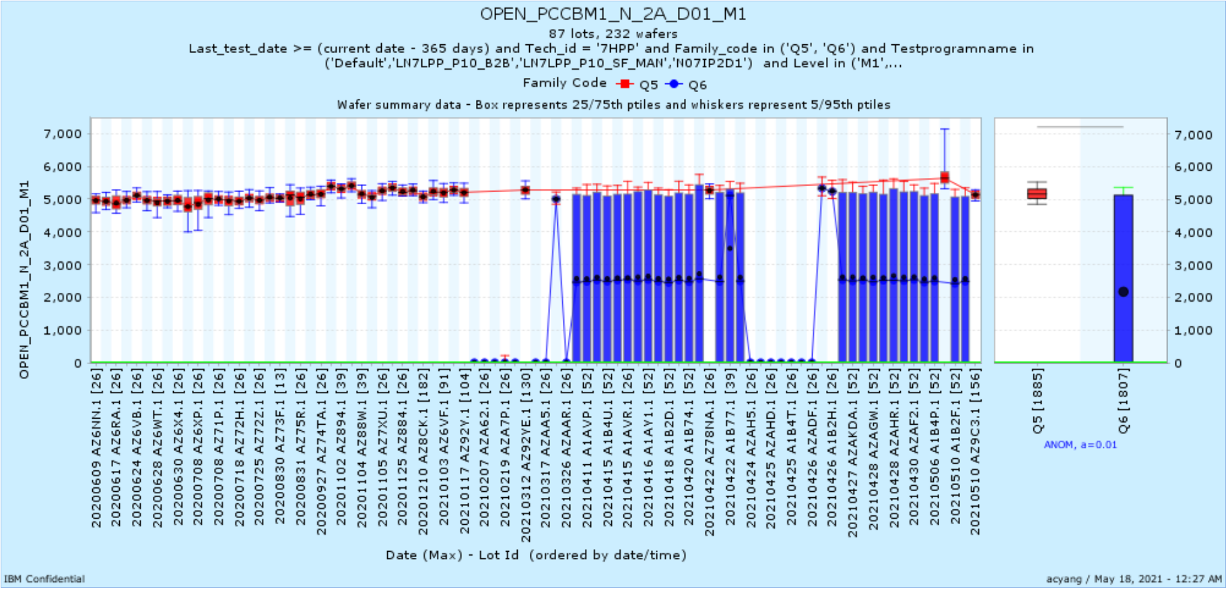
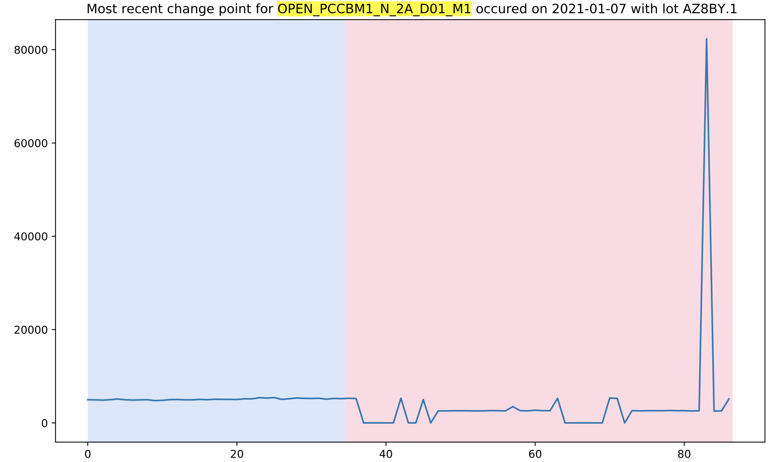
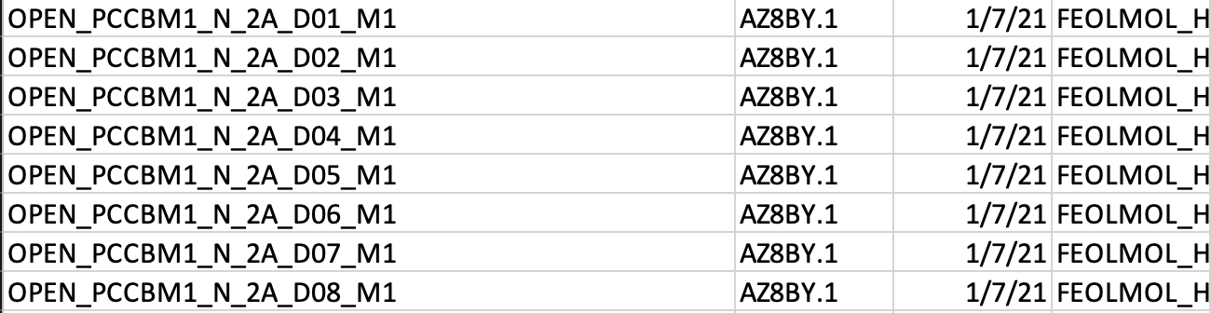
FEOLMOL_HOL

Slide 8
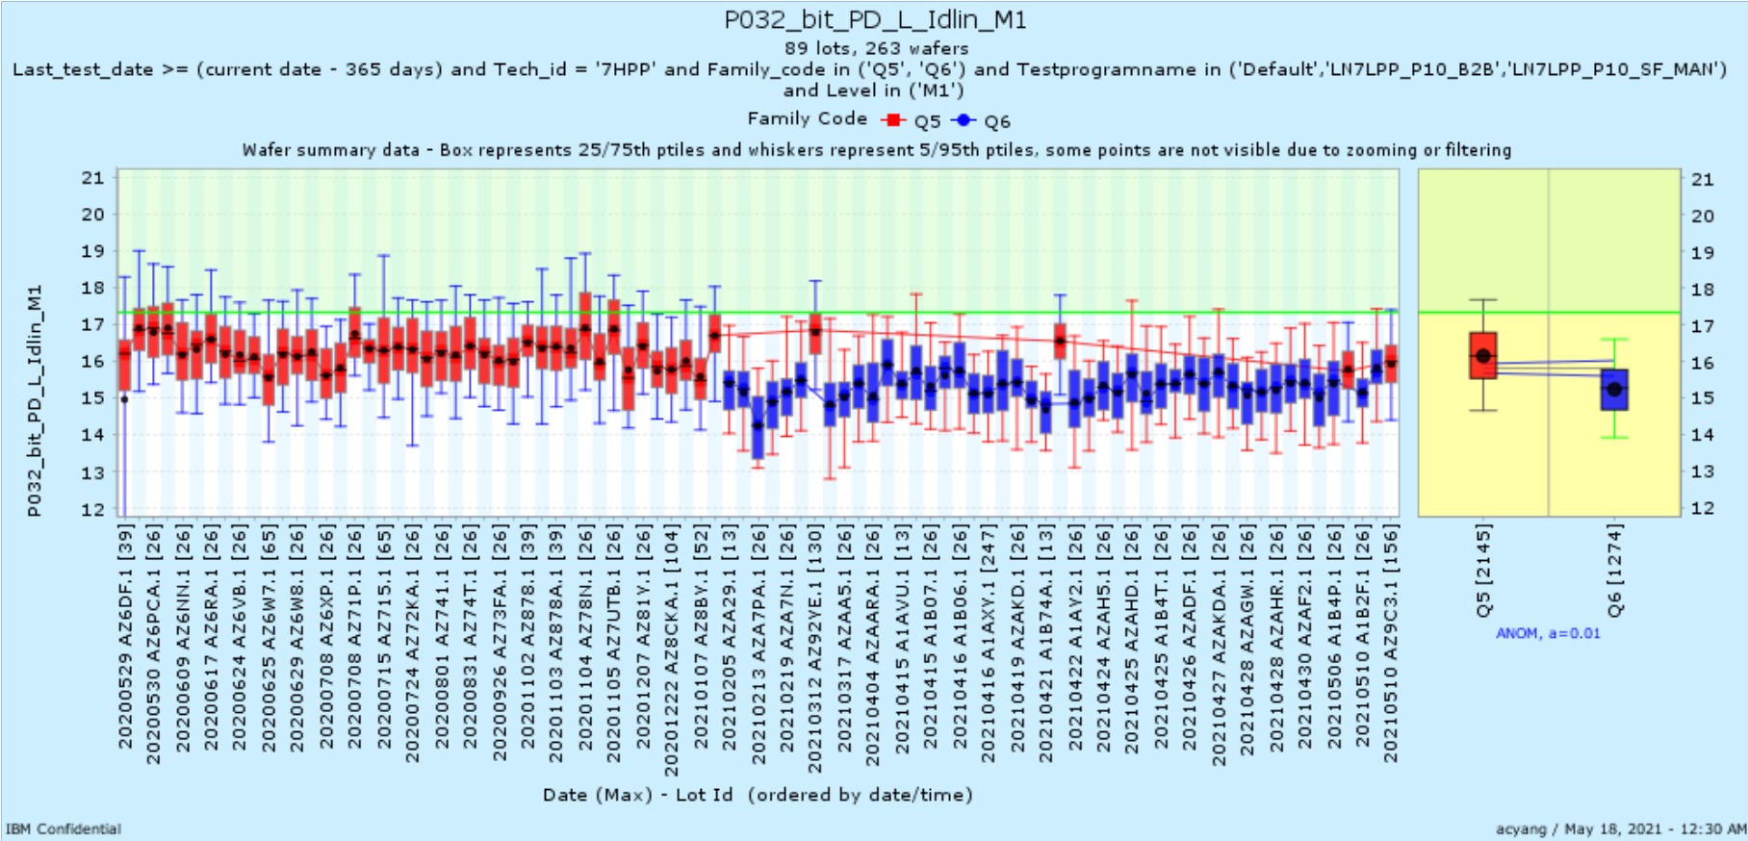
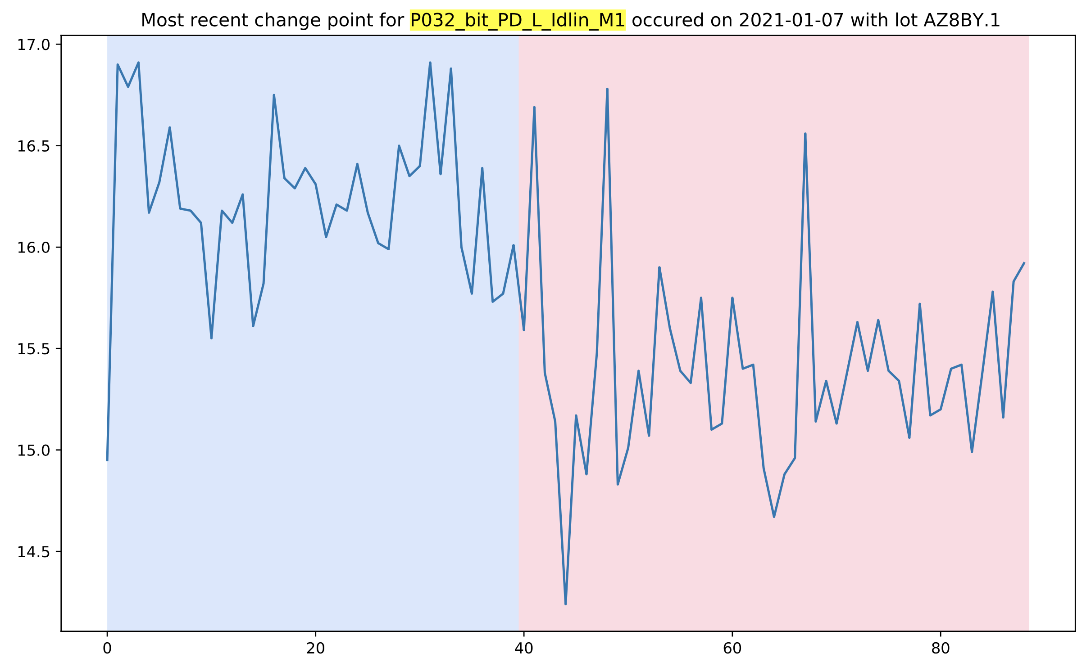
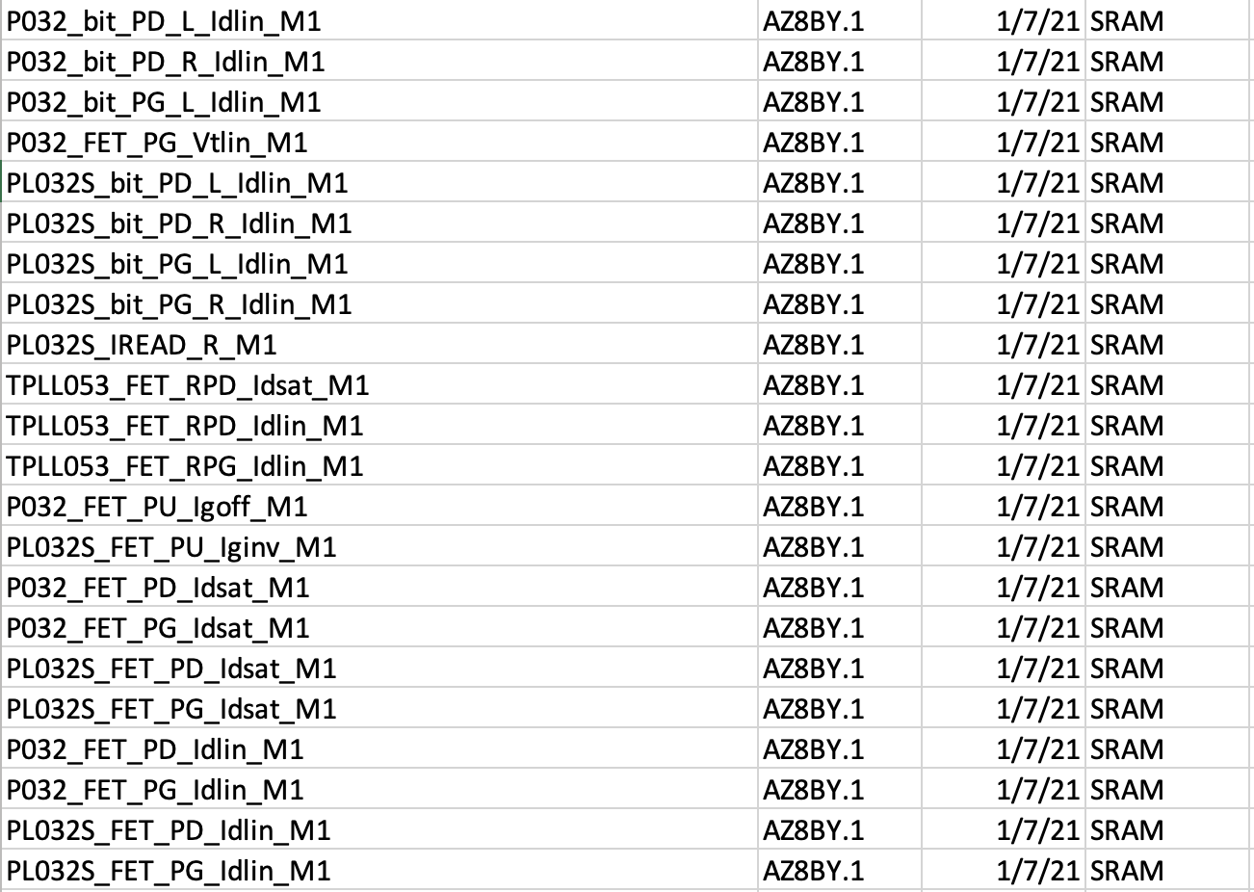
SRAM

Slide 9
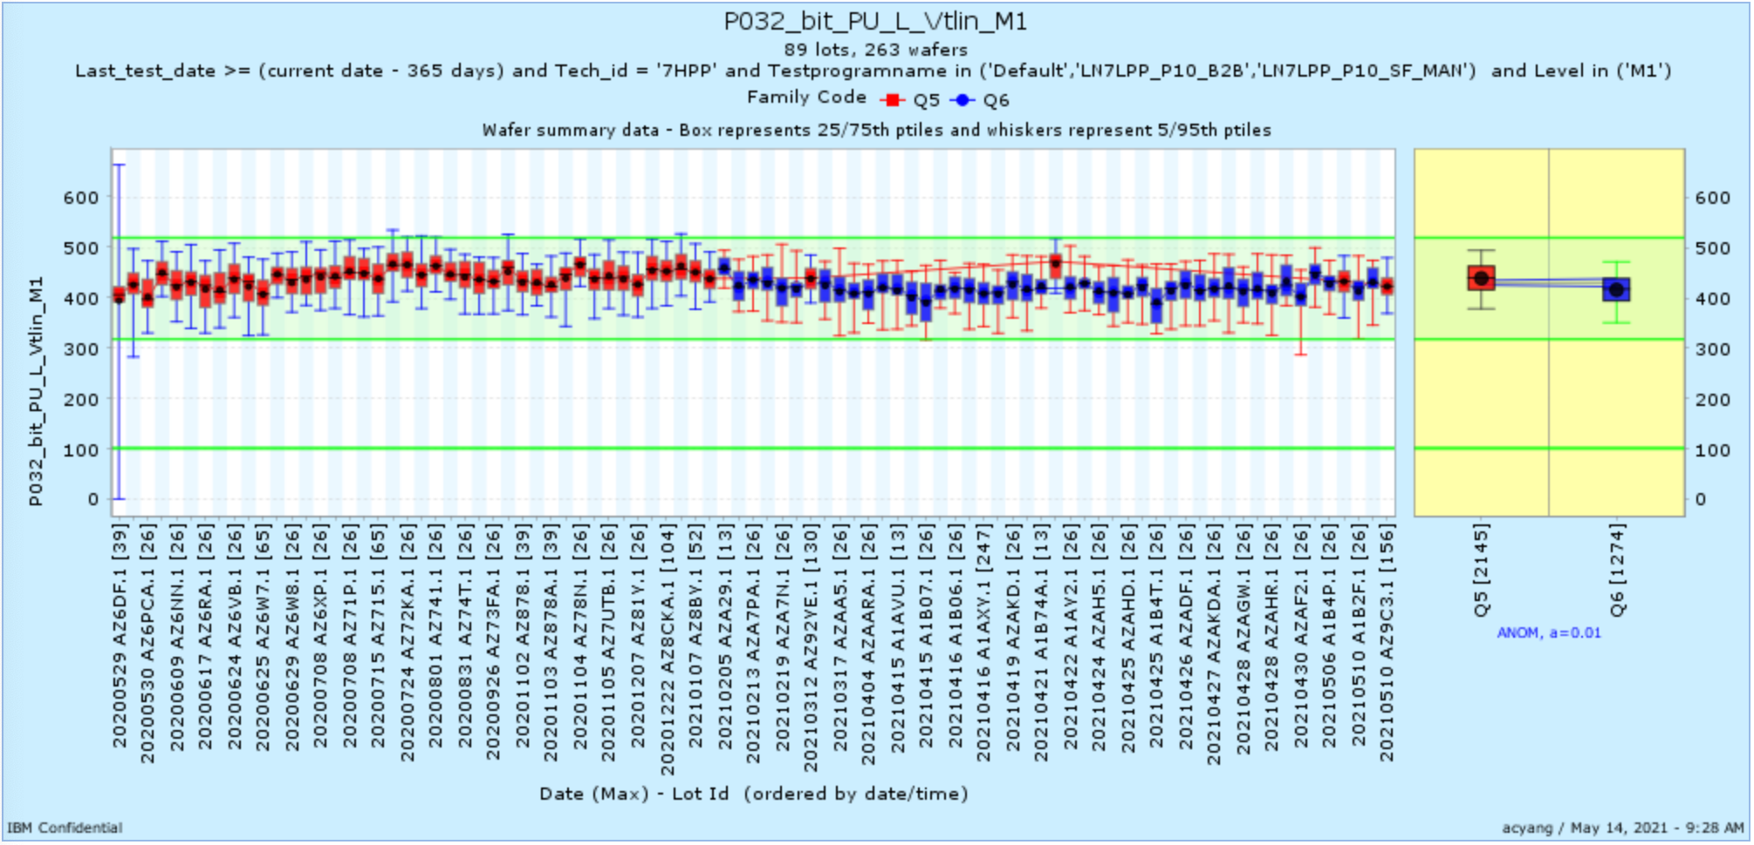
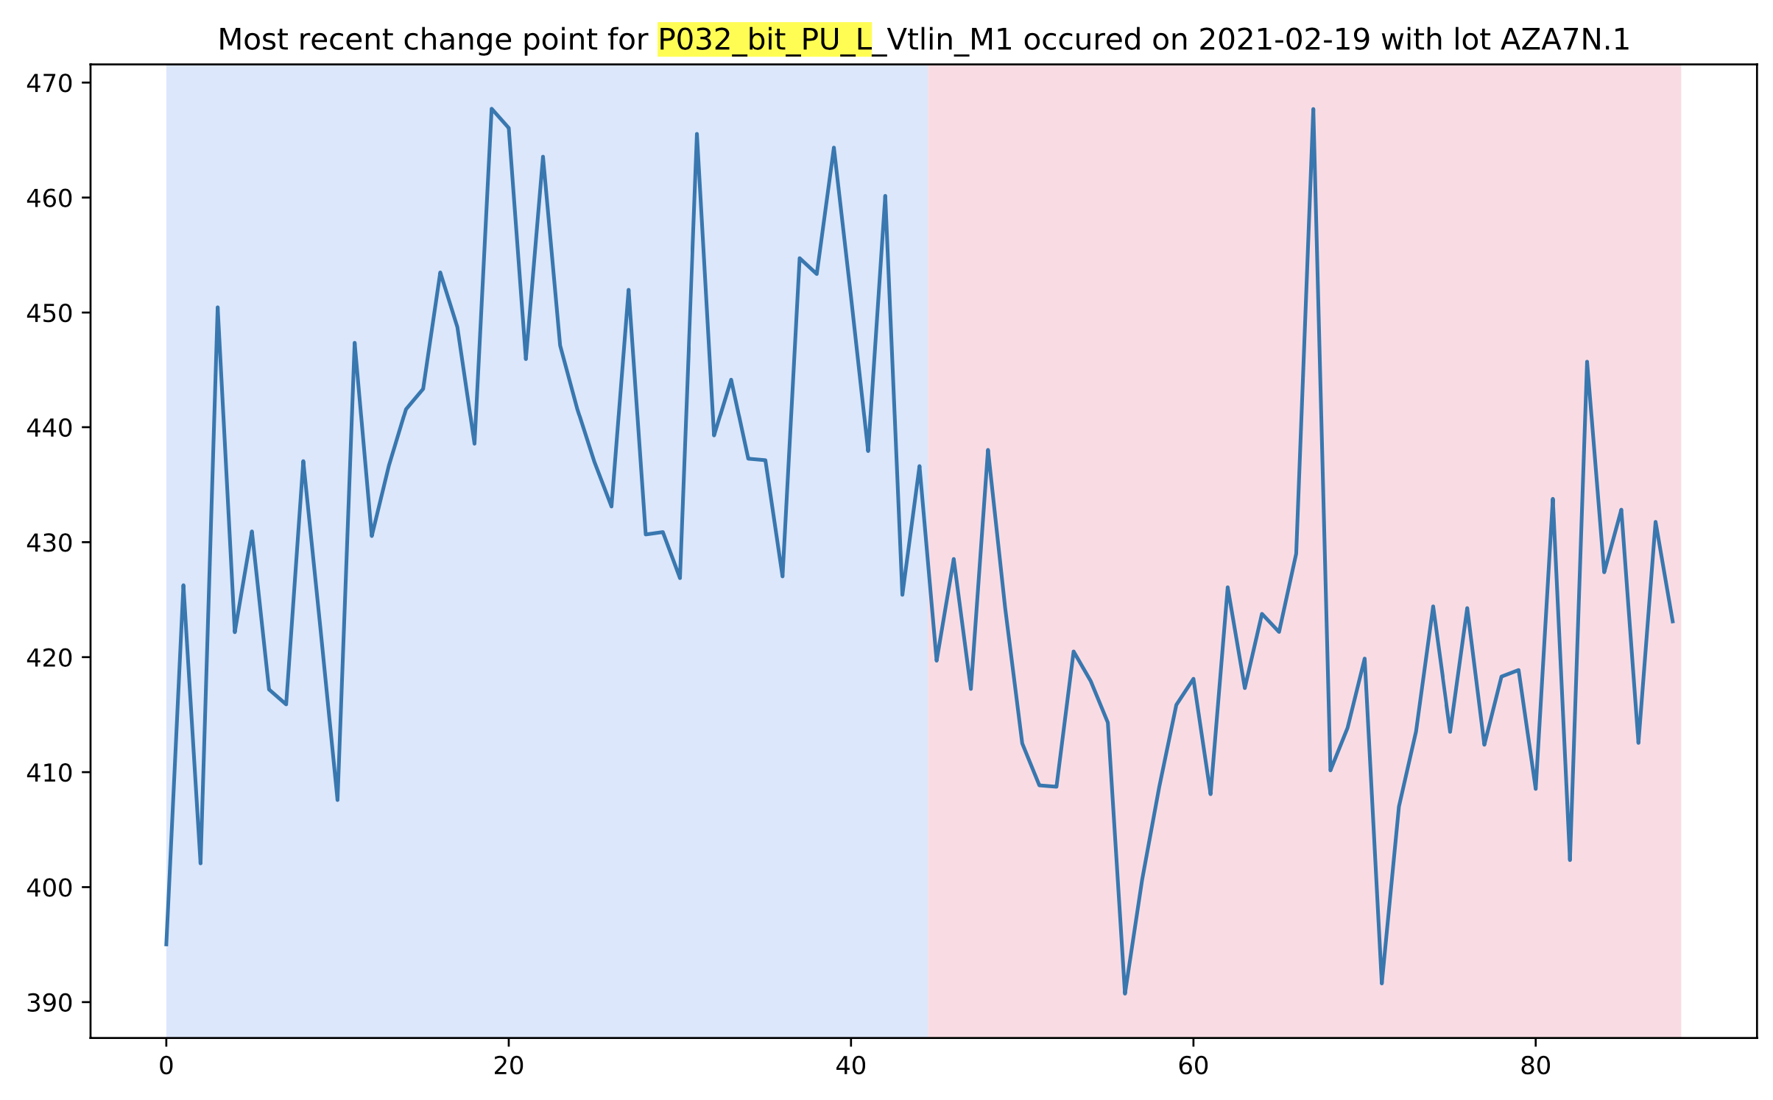
This SRAM example is pretty subtle to the naked eye

Slide 10
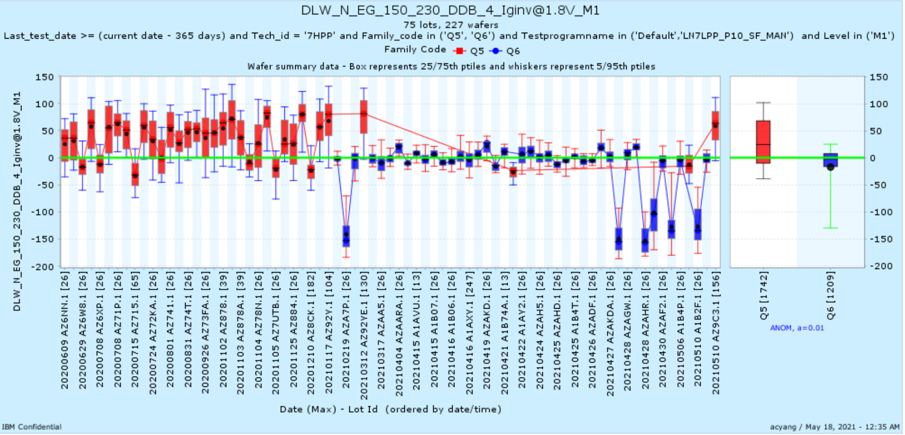
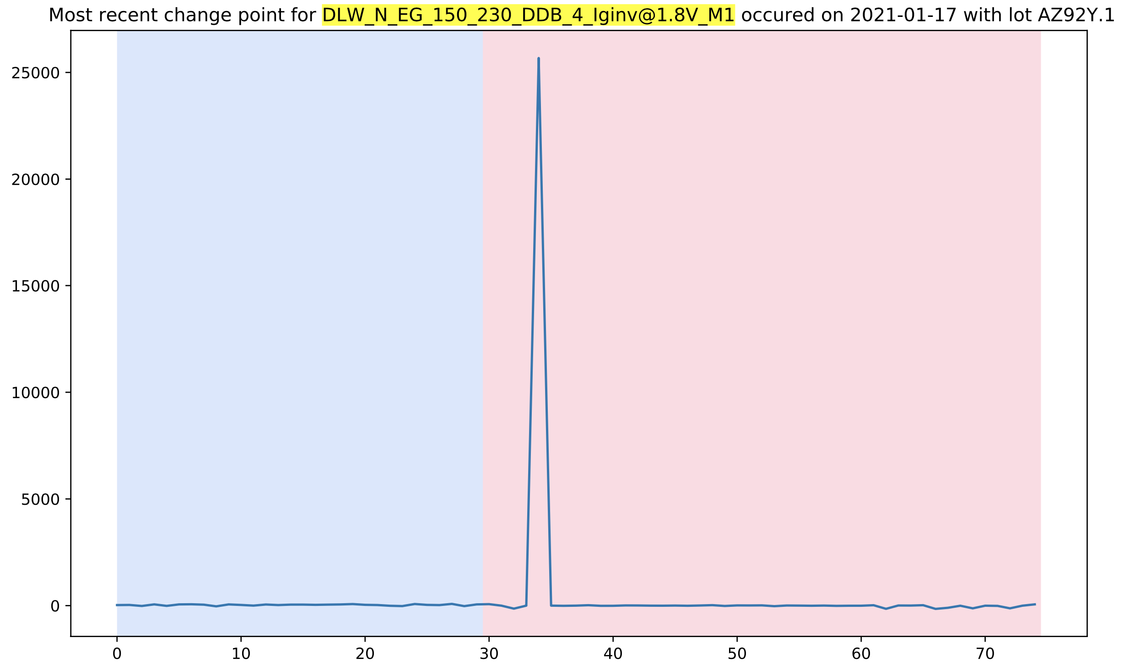
Device

Slide 11
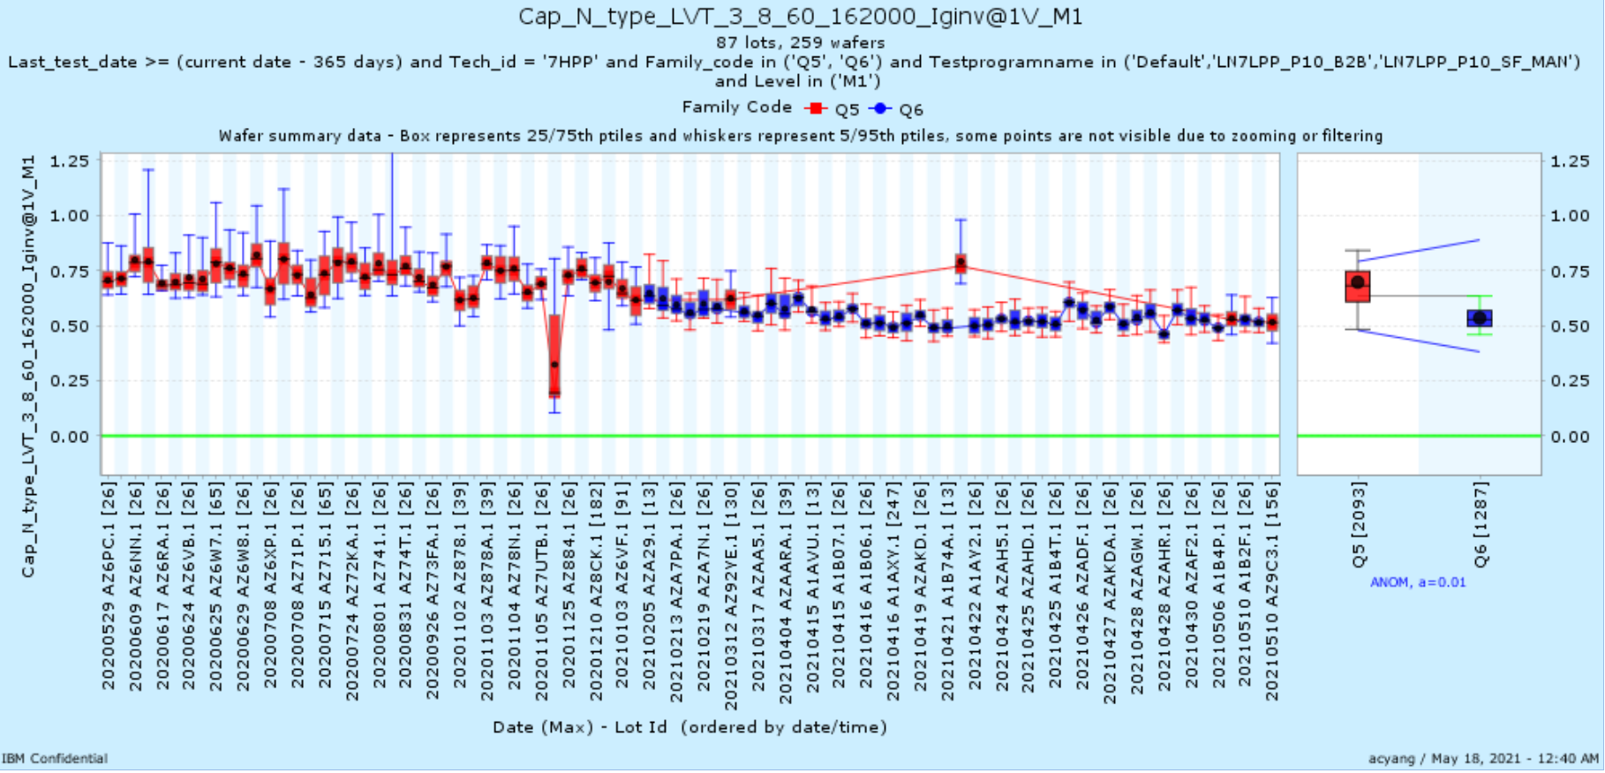
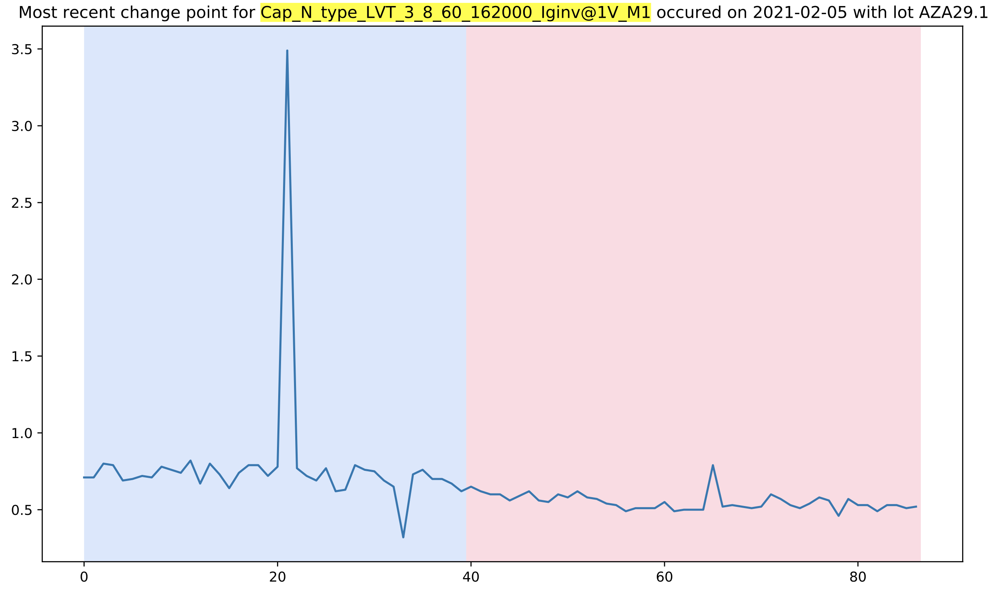
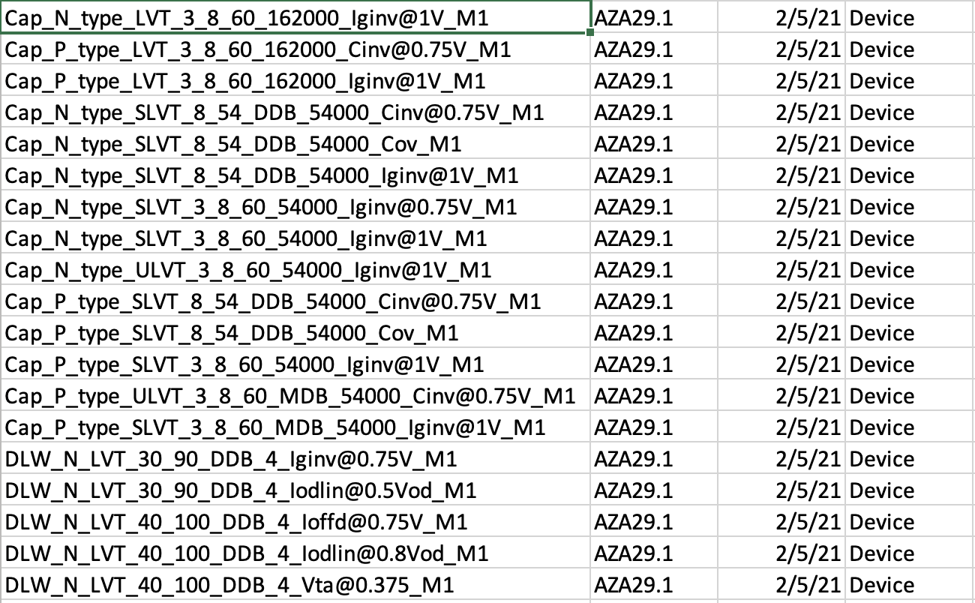
This was a gradual shift but we caught the exact DD2 shift date
About 140 device parameters shifted on this date

Slide 12
Examples of Recent Change Points

Slide 13
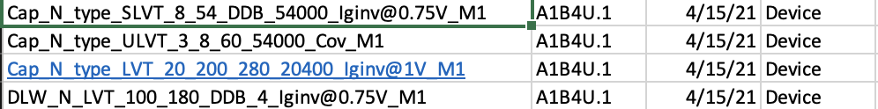
4 Recent Device shifts all on 4/15/2021 starting with lot A1B4U.1
A1B4U is the first “A1B” lot
Lot before A1B4U is A1AVU

Slide 14
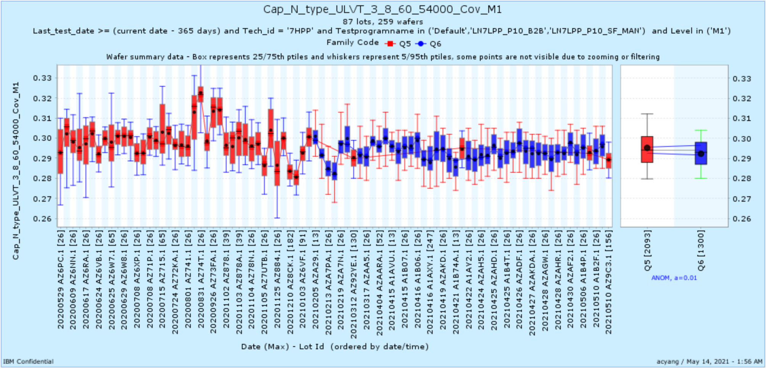
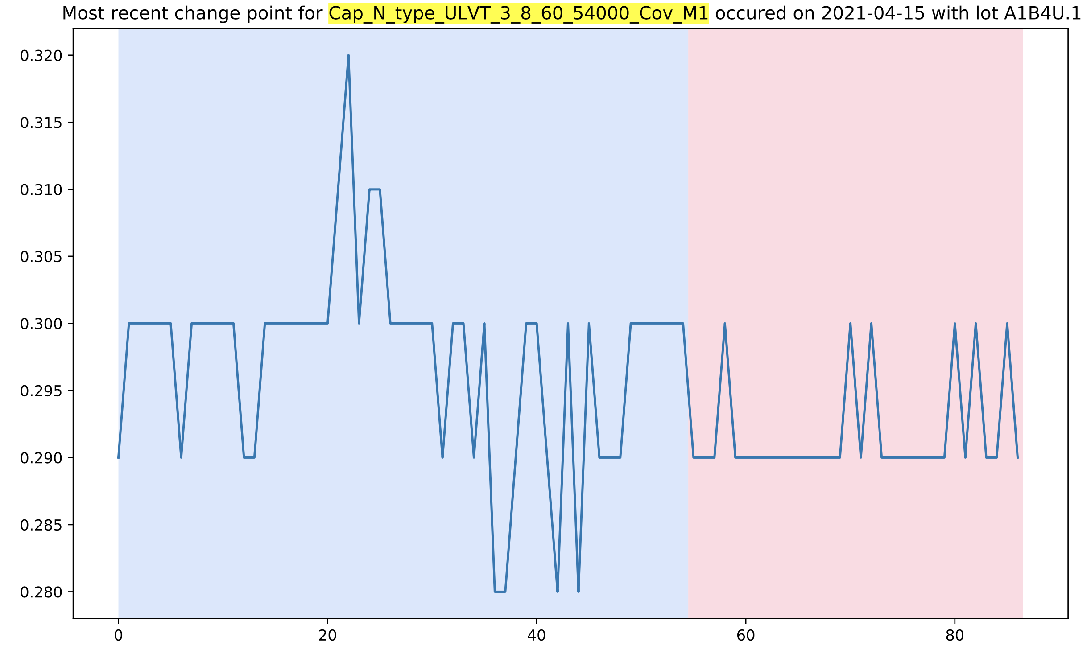

Slide 15
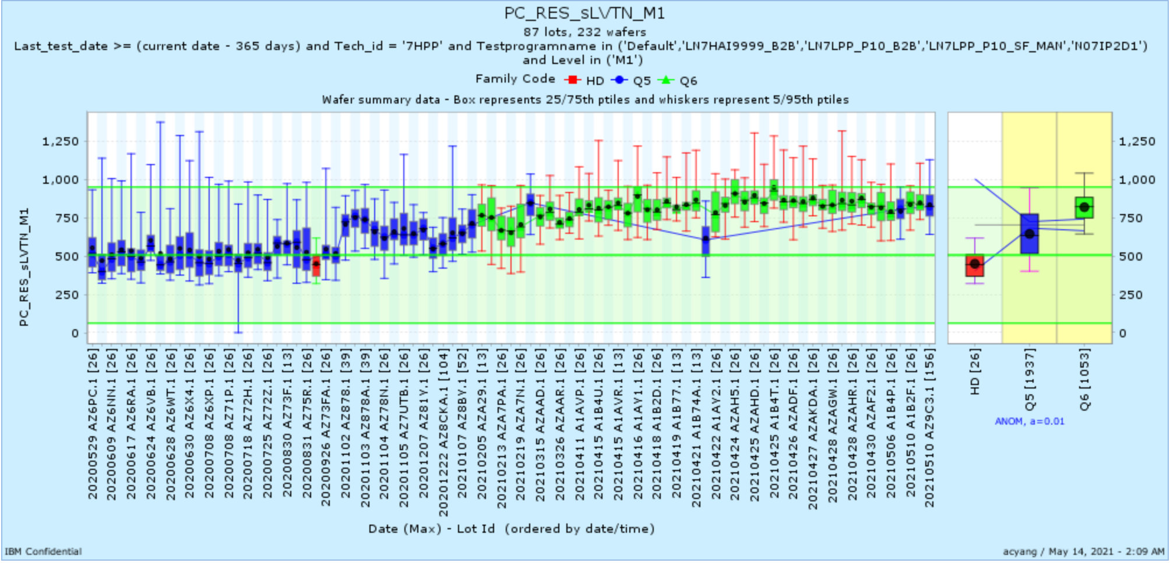
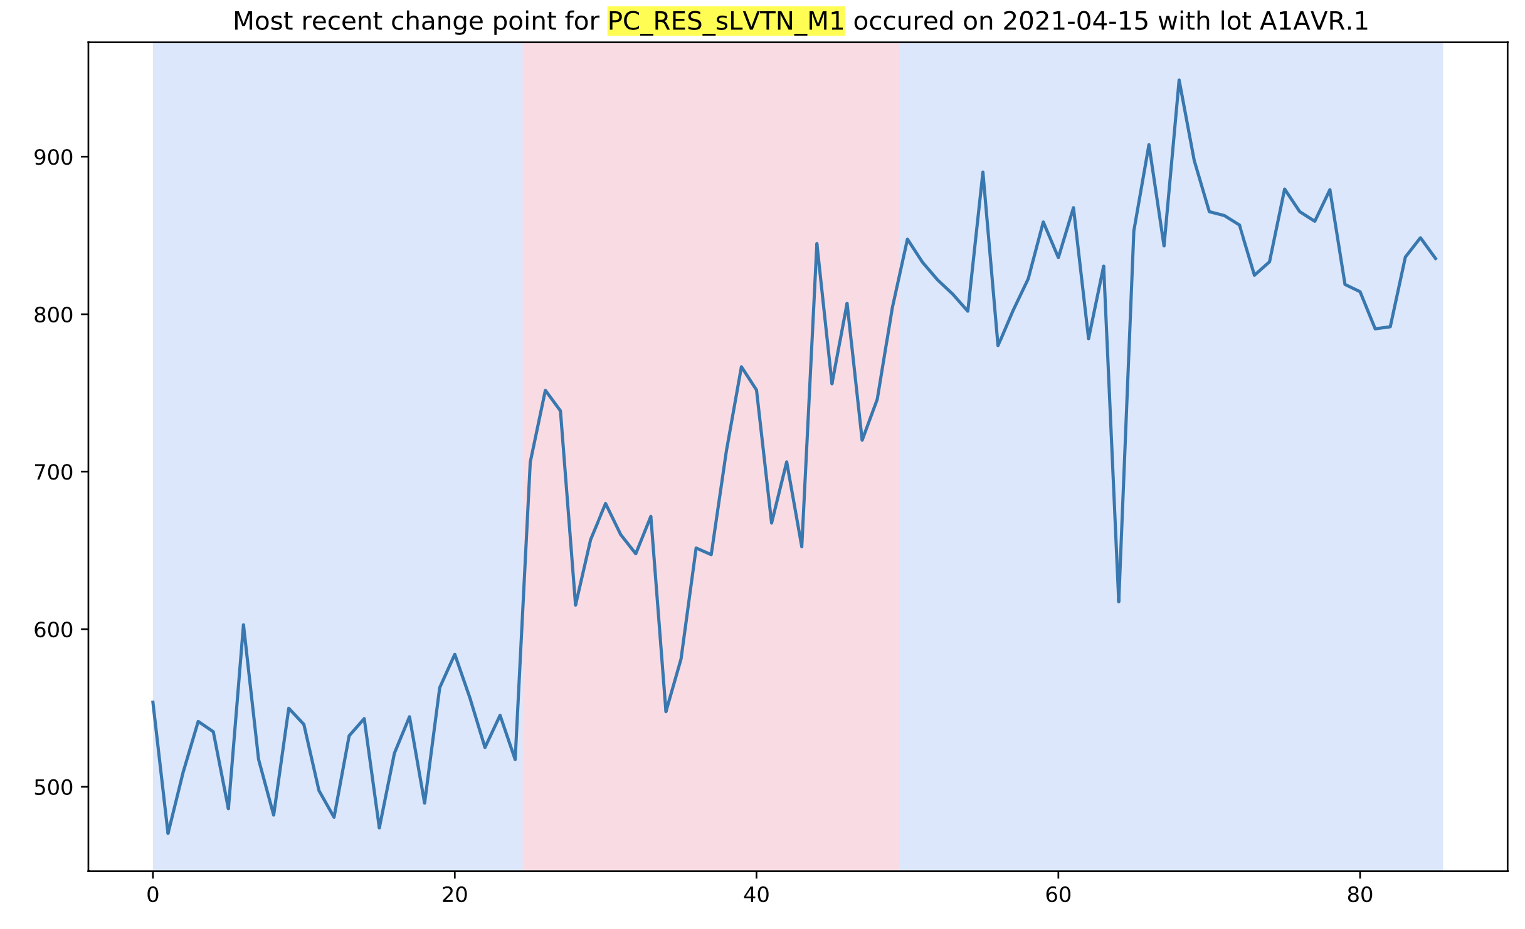

Slide 16
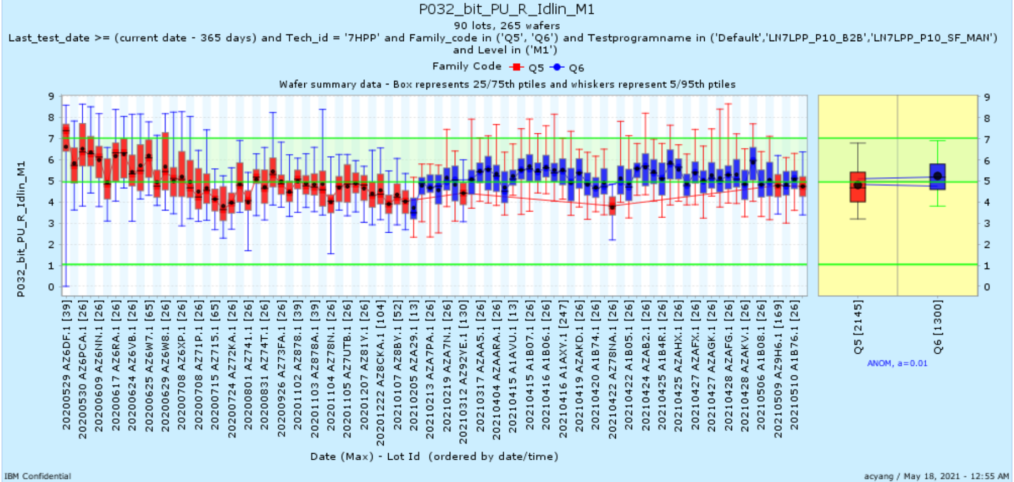
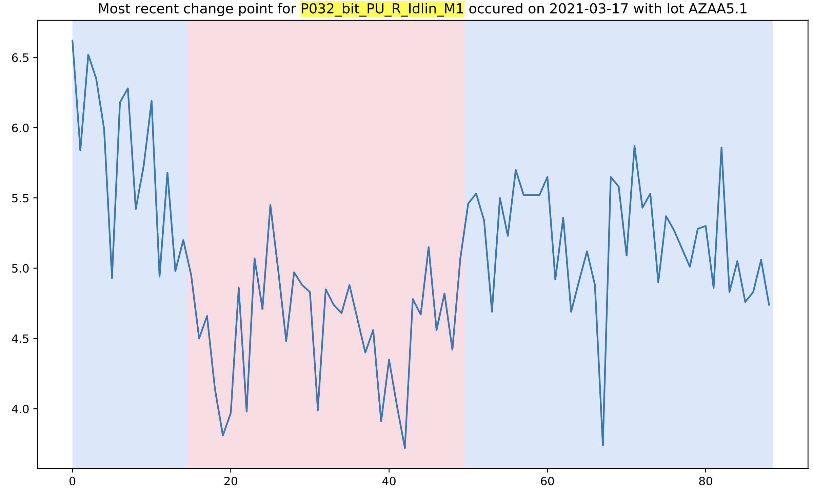

Slide 17
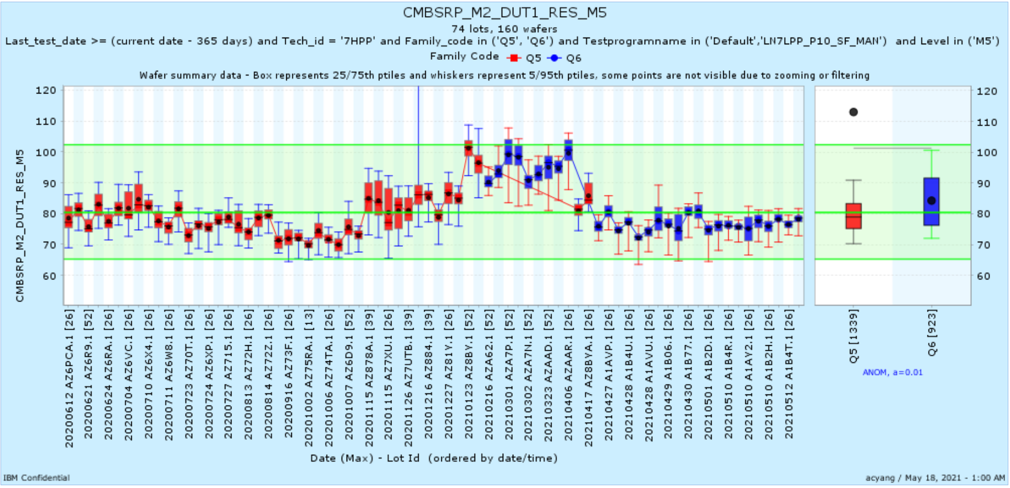
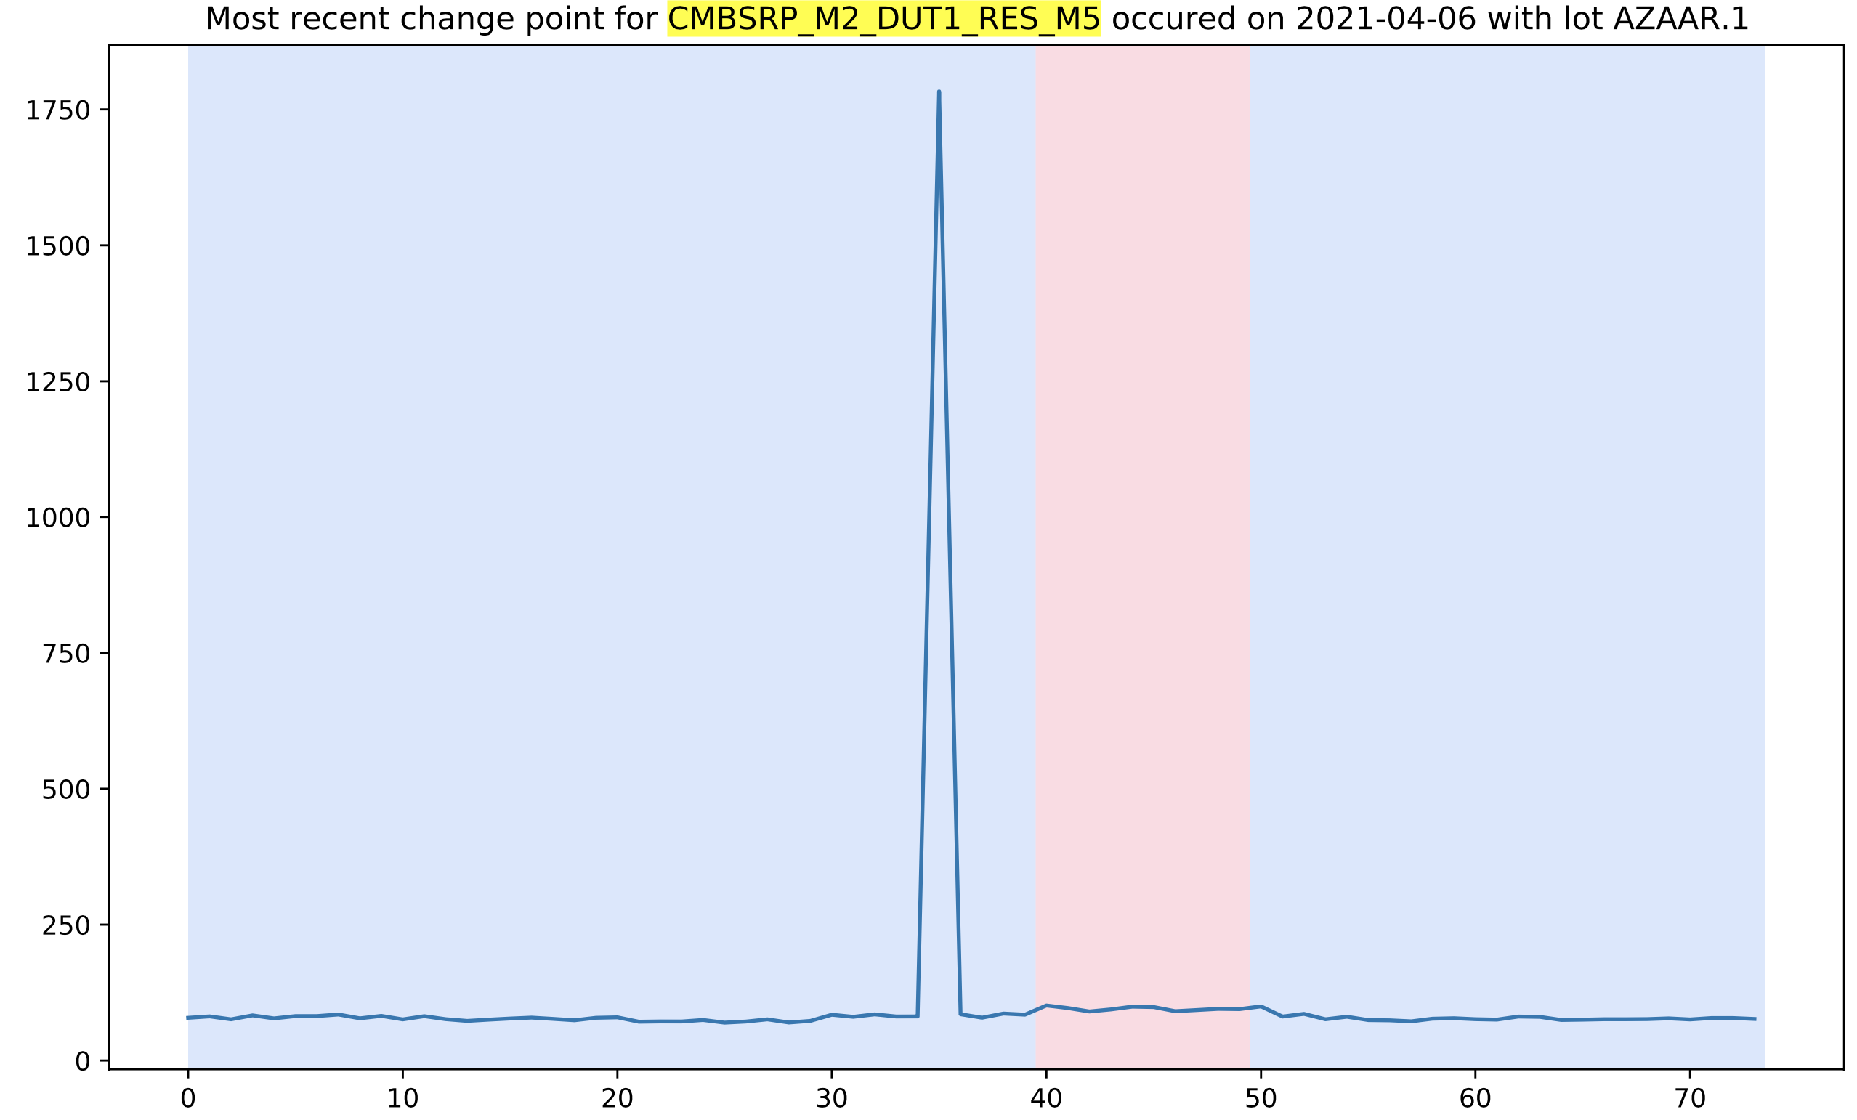
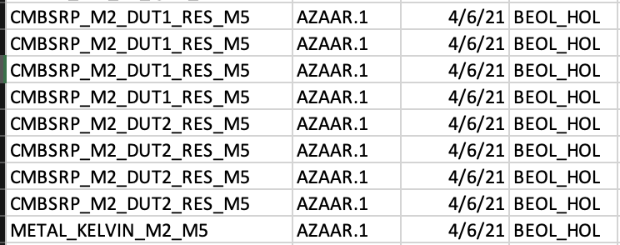

Slide 18
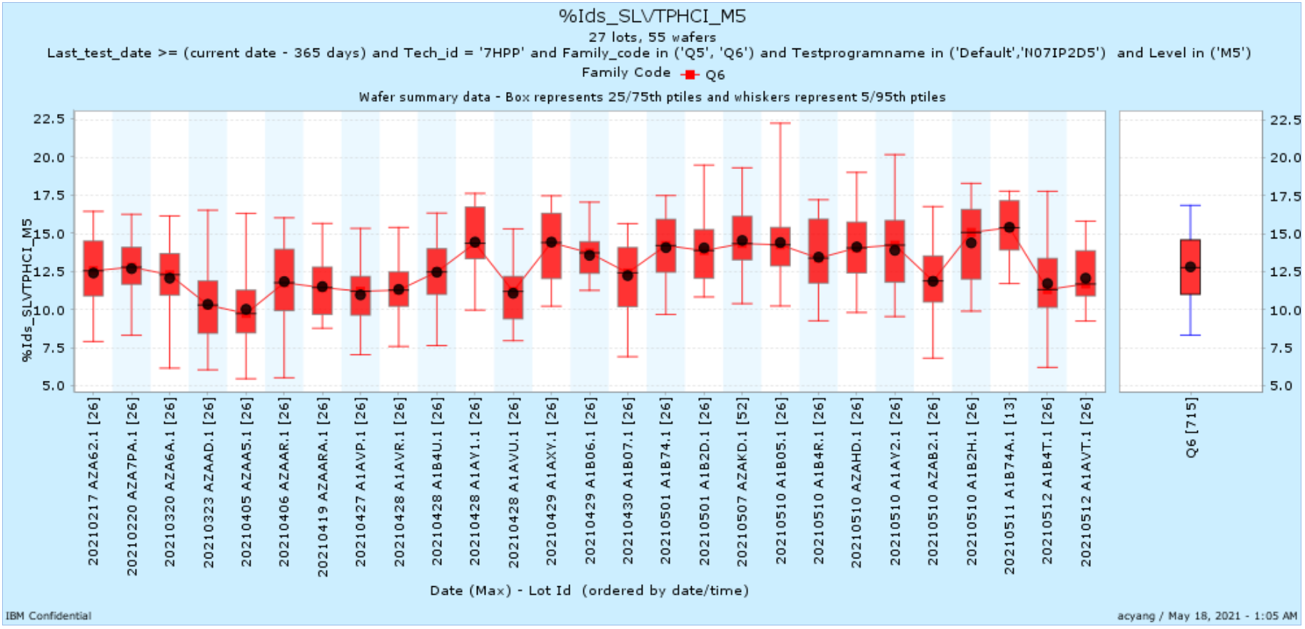
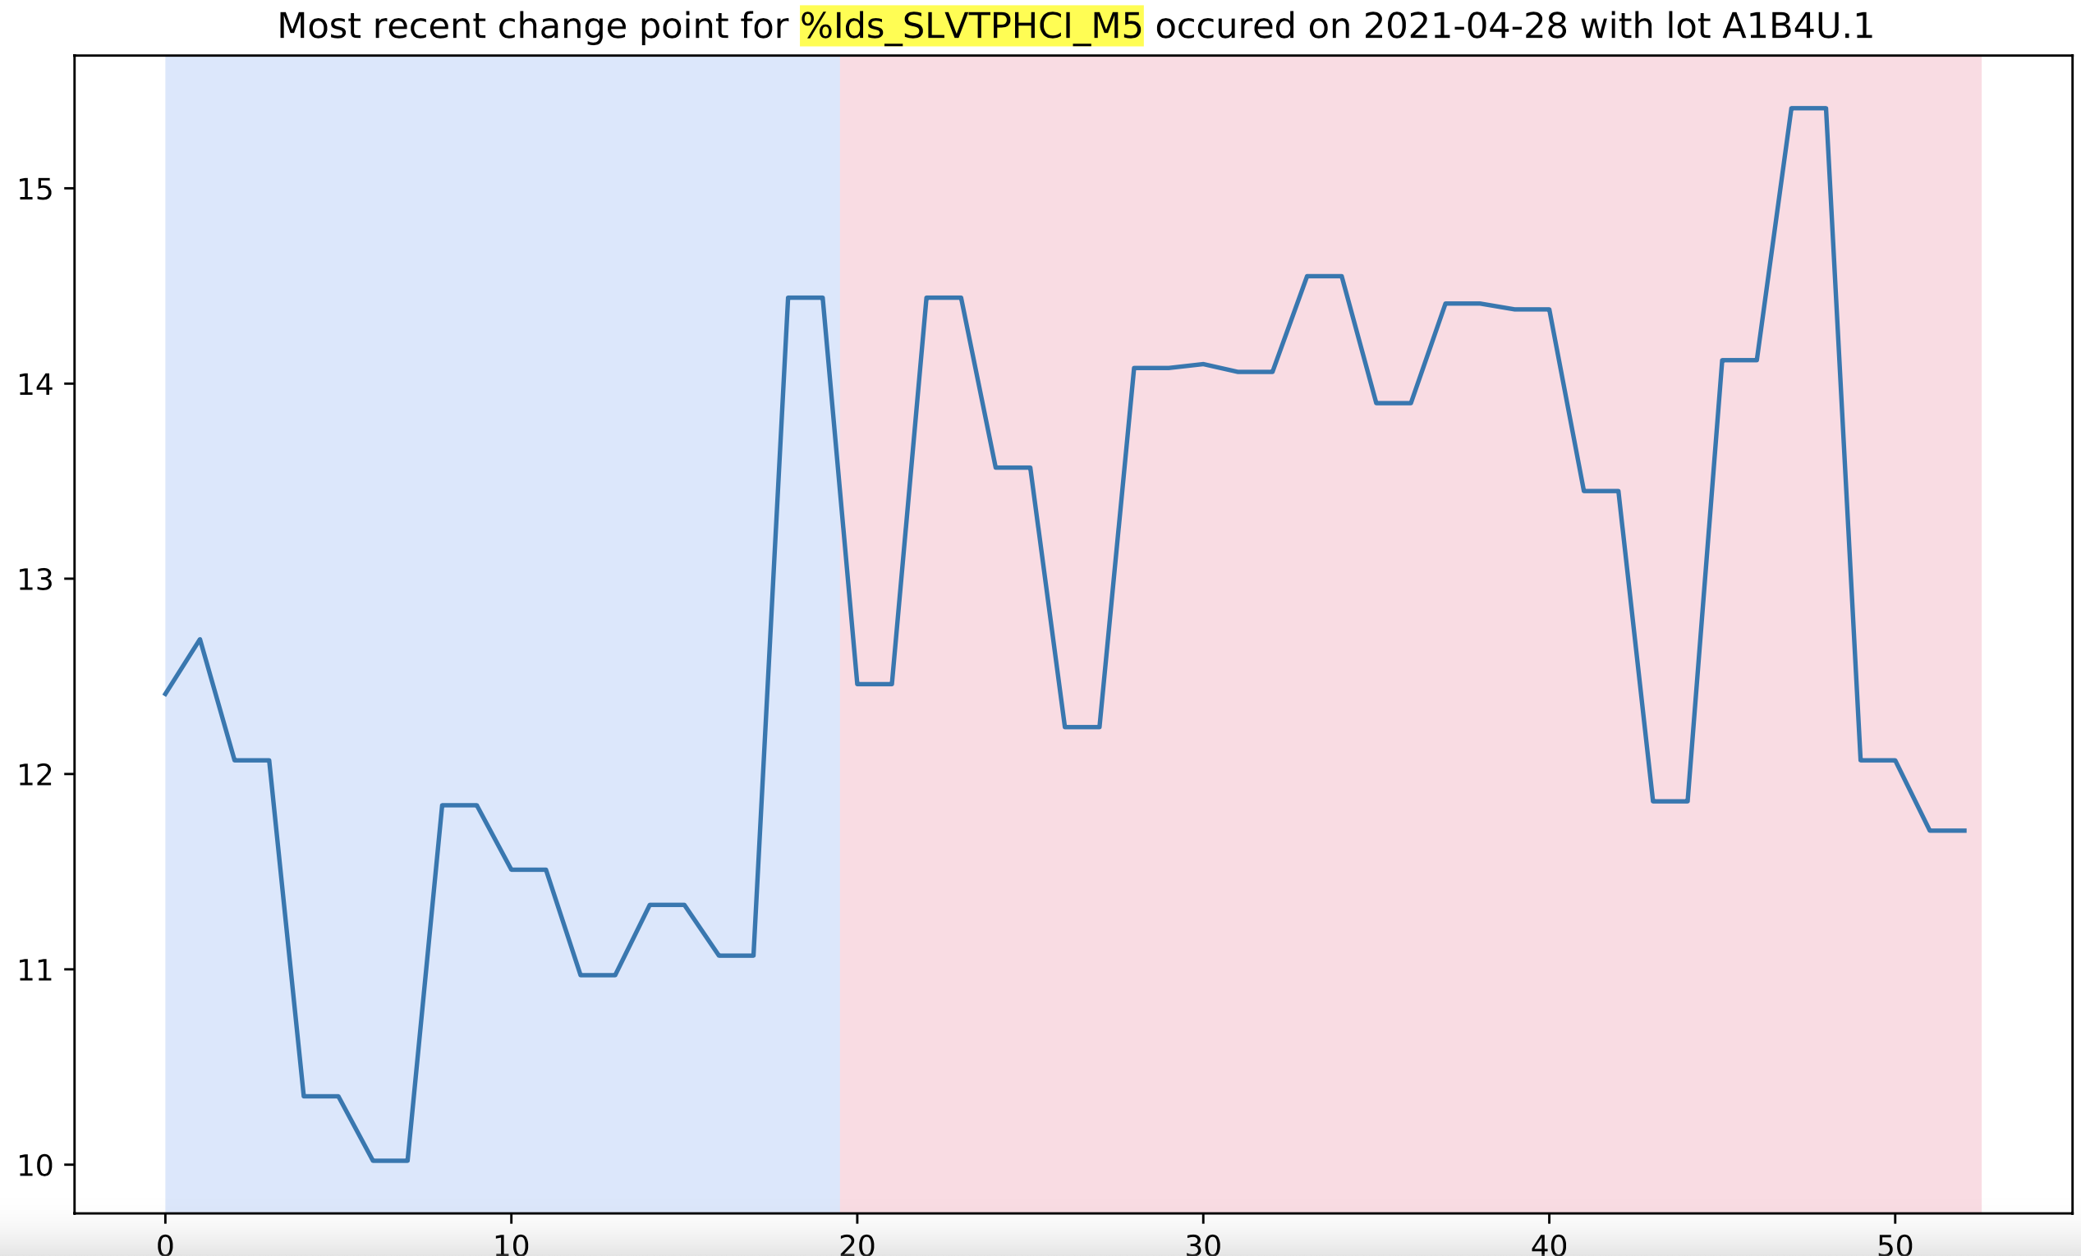

Slide 19
Entire Data Logistics
2737 M1 parameters: 3 hours to run (4 seconds per parameter)
415 historical change points detected (Over half of these are DD2 shifts)
7 change points detected in April (4 unique change points)
14 change points detected in March (3 unique change points)
1699 M5 parameters: 1.8 hours to run (3.9 seconds per parameter)
272 historical change points detected
38 change points detected in April (8 unique change points)
39 change points detected in March (5 unique change points)

